Slide 1
3-D QSAR and drug design Analysis
Team:2
Aravind s Harilal : cb.sc.u4aie24008
Adhwaidh k : cb.sc.u4aie24003
Anirudh Jayan : cb.sc.u4aie24007
Sarvesh Ram Kumar : cb.sc.u4aie24048

Slide 2
INTRODUCTION:
• Drug discovery is a long, costly, and complex process
• Traditional met\hods require extensive laboratory testing
• QSAR (Quantitative Structure–Activity Relationship) links chemical structure with biological activity
• 3-D QSAR considers the three-dimensional structure of molecules
• It analyzes shape, size, charge distribution, and molecular interactions
• 3-D QSAR helps predict drug activity and optimize drug design
• It plays an important role in modern pharmaceutical research

Slide 3
oBJECTIVES
• To understand the basic concept of Quantitative Structure–Activity Relationship (QSAR)
• To study the importance of three-dimensional molecular properties in drug activity
• To analyze the role of 3-D QSAR in modern drug design and discovery
• To learn about major 3-D QSAR techniques such as CoMFA and CoMSIA
• To explain the steps involved in performing a 3-D QSAR analysis
• To evaluate the applications, advantages, and limitations of 3-D QSAR in drug development
• To highlight how 3-D QSAR helps in designing safer and more effective drugs

Slide 4
Problem statement
Experimental drug discovery and optimization is complex, time-consuming, and often limited by high costs and extensive laboratory testing.
Understanding how molecular structure influences biological activity is challenging due to the involvement of three-dimensional interactions such as steric effects, electrostatic forces, and hydrophobic interactions.
Traditional QSAR methods do not fully capture these spatial interactions, leading to limited accuracy in predicting drug activity. Hence, a computational approach is required to analyze and optimize drug–target interactions using three-dimensional molecular information.
This project employs 3-D Quantitative Structure–Activity Relationship (3-D QSAR) analysis to study the relationship between molecular structure and biological activity, enabling accurate activity prediction and rational drug design.
Key Focus Points:
• Analyze three-dimensional molecular properties affecting drug activity
• Study steric, electrostatic, and hydrophobic interactions
• Predict biological activity of compounds computationally
• Assist in optimizing drug candidates with improved efficacy and safety

Slide 5
Dataset description
The study uses the ESOL (Delaney) dataset, a benchmark dataset widely used for molecular solubility prediction in QSAR studies.
The dataset consists of drug-like small organic molecules with experimentally measured aqueous solubility values expressed as log solubility (mol/L).
Each molecule is represented using a SMILES string, which encodes its chemical structure and serves as input for 3D structure generation.
The dataset includes precomputed physicochemical descriptors such as molecular weight, hydrogen bond donors, number of rings, rotatable bonds, and polar surface area. The measured log solubility is used as the target variable for training and evaluating the 3D-QSAR machine-learning model.
The chemical diversity of the dataset makes it suitable for QSAR modeling and machine-learning–based property prediction.
The dataset supports 3D-QSAR analysis by enabling conversion of SMILES into optimized three-dimensional molecular conformations.

Slide 6
Methodology
1. Dataset Collection
A curated molecular dataset containing SMILES representations and experimentally measured log solubility values was used for this study.
The SMILES strings describe the 2D chemical structures, while the measured log solubility serves as the target property for QSAR modeling. Missing or invalid entries were removed prior to analysis.
2. Molecular Structure Representation
The chemical structures of the drug molecules are represented in three-dimensional form.
This allows the spatial arrangement of atoms, bond lengths, and angles to be considered, which is essential for 3-D QSAR analysis.
3. Calculation of Molecular Descriptors
Three-dimensional molecular descriptors are calculated from the structures. These descriptors numerically represent important molecular properties such as steric effects, electrostatic charge distribution, and hydrophobicity, which influence drug–target interactions.

Slide 7
4. SMILES to 3D Structure Generation
Since 3D-QSAR requires spatial information, SMILES strings were not used directly for model training.
Instead, each SMILES was converted into a three-dimensional molecular conformer using RDKit. Hydrogen atoms were explicitly added, followed by 3D coordinate generation using the ETKDG algorithm.
The resulting conformers were geometry-optimized using the Universal Force Field (UFF) to obtain energetically reasonable molecular structures.
5. 3D Descriptor Extraction
From the optimized 3D molecular structures, a set of shape-based and physicochemical descriptors was calculated. These descriptors numerically encode molecular geometry and properties relevant to solubility and drug-like behavior.
The extracted features included:
Molecular Weight, LogP, Topological Polar Surface Area (TPSA), Number of Hydrogen Bond Donors, Number of Hydrogen Bond Acceptors and more
These descriptors formed the feature matrix (X) used for machine-learning modeling. The measured log solubility values constituted the target variable (y).

Slide 8
6. Feature Matrix Construction
The extracted descriptors were aggregated into a numerical feature table, ensuring consistent feature ordering across all molecules.
SMILES strings were retained only for reference and feature generation, and were excluded from the machine-learning input to maintain numerical consistency.
7. Data Splitting and Scaling
The dataset was divided into training and testing sets using an 80:20 split.
Feature scaling was applied using standardization to normalize descriptor ranges and improve model stability. The scaler was fitted on the training data and applied consistently to both training and test sets.
8. Model Training (3D-QSAR)
A Random Forest Regressor was employed to construct the 3D-QSAR model due to its robustness, ability to handle nonlinear relationships, and strong performance on QSAR datasets.
The model was trained using the 3D molecular descriptors to learn the relationship between molecular structure and solubility.

Slide 9
9. Model Validation
Model performance was evaluated on the unseen test set using statistical metrics such as:
Coefficient of determination (R²)
Root Mean Square Error (RMSE)
These metrics quantify the predictive accuracy and generalization ability of the developed 3D-QSAR model.
10. Prediction of New Molecules
For drug analysis and design applications, new molecules were introduced in the form of SMILES strings.
These SMILES were converted into 3D conformers, the same set of descriptors was extracted, and the trained model was used to predict their solubility values.
This demonstrates the applicability of the model for virtual screening and property prediction.

Slide 10
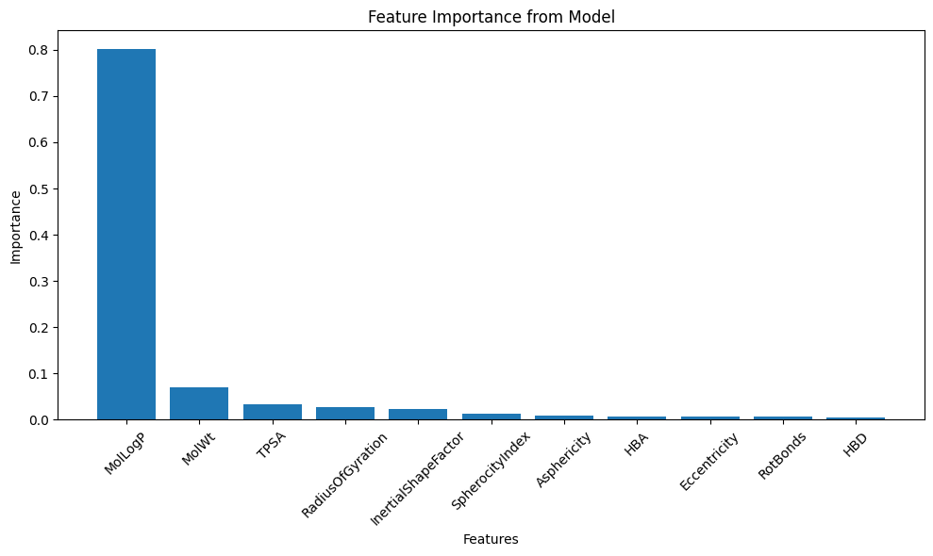
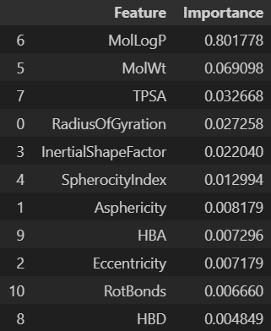
Results
R² Score: 0.8651407884624194
RMSE: 0.7984065328422615

Slide 11
conclusion
In this study, a complete 3D-QSAR and machine-learning pipeline was successfully developed to predict molecular solubility from chemical structure.
SMILES representations were transformed into optimized three-dimensional conformers, enabling the extraction of meaningful 3D shape and physicochemical descriptors.
The results demonstrate that 3D molecular features provide valuable information for predicting drug-relevant properties, and that machine-learning models can effectively leverage these features for accurate prediction.
The developed approach allows for the rapid evaluation of new molecules prior to synthesis, making it highly suitable for drug discovery and molecular design workflows.

